Slide 1
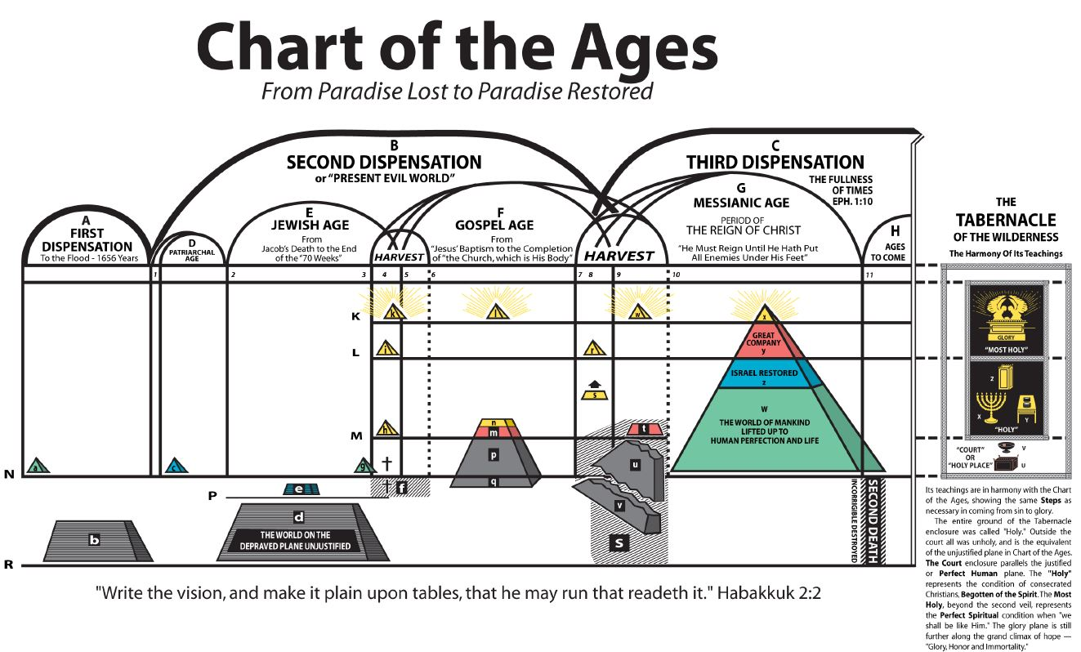
WHAT IS THE MEANING OF THIS CHART?
PART II

Slide 2
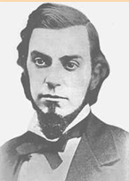
WHO DEVELOPED THE CHART OF THE AGES?
CHARLES RUSSELL

Slide 3
WHAT IS THAT CHART ON YOUR WALL?
This “Chart Of The Ages” is an
“illustration of the Plan of God
for the world’s salvation”

Slide 4
1845 Years
“P” Shows the Typical Justification of Natural Israel.

Slide 6
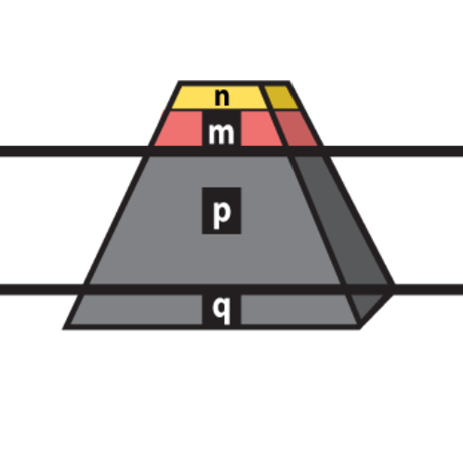
This partial pyramid n, m, p, q united represents the Nominal Church down through the gospel age, claiming to be the body of Christ.
The “little flock” of consecrated children of the heavenly father down through the Gospel Age.
Rev. 2:10 Be thou faithful unto death and I will give thee a crown of life
Matt 25:1-3 “And five of them were wise, and five were foolish. They that were foolish took their lamps, and took no oil with them.”
PLANE “M”
n
Those of the “p” class receive the grace – favor – “justification” of God in vain. 2 Cor. 6:1
m
Wolves in Sheep’s clothing
p
PLANE “N”
q

Slide 7
“Plane M” Having consecrated all, we are begotten of the Spirit.
PLANE “M”

Slide 8
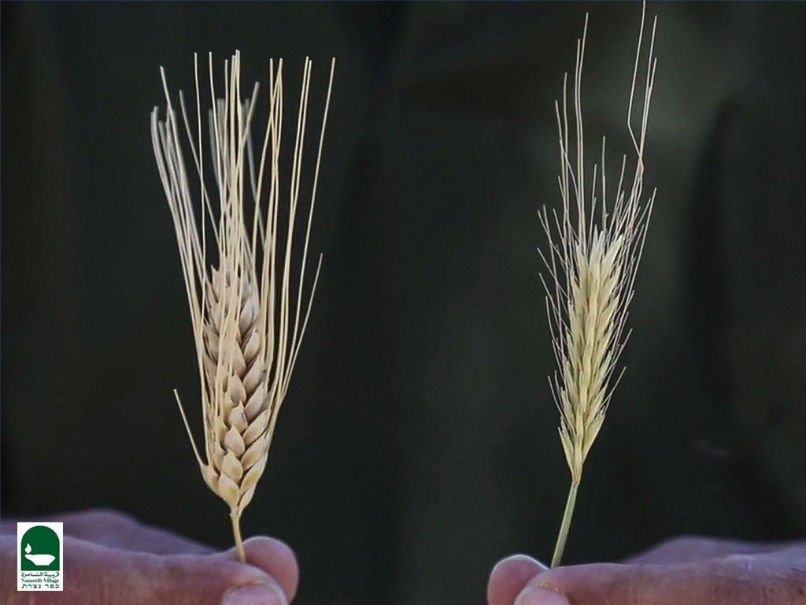
Wheat and Tares grow together.
All of class “q”, and many of class”p”, are therefore “tares”; for “no man can serve two masters,” and “his servats you are to whom you render service.”
The Wheat
PLANE “M”
PLANE “N”

Slide 9
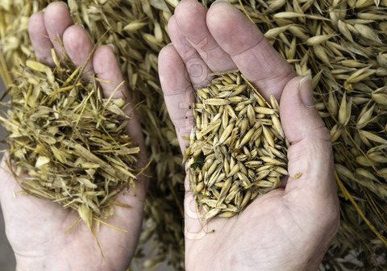

Slide 11
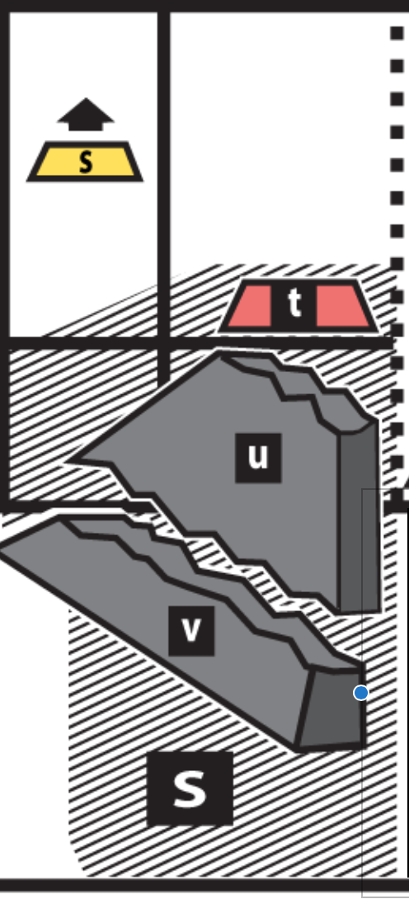
but gather the wheat into my barn.
Matt 13:30 Let both grow together until the harvest: and in the harvest I will say to the reapers,
PLANE “M”
PLANE “N”
Gather ye together first the tares, and bind them in bundles to burn them:
“S” Fire of “Trouble”

Slide 12
“w” Christ and Church in Glory…This is the Glory of Power and Dominion
“r” Jesus returns and receives his bride
The first work of our Lord in the harvest of the Gospel age is under the supervision of the chief reaper, our Lord Jesus, who must then be present.
Those who built on the gold, silver and precious stones of truth are represented by figure “s”.

Slide 13
“Plane K” (Rev. 19:7) Let us be glad and rejoice, and give honor to him: for the marriage of the Lamb is come, and his wife hath made herself ready.
PLANE “K”
“K” The unifying & full glorification of the entire Body of Christ with the Head. This is the marriage of the Lamb
(Rev. 19:7)

Slide 16
Rev 18:23
And the light of the candle shall shine no more at all in thee: and the voice of the bridegroom and of the bride shall be heard no more at all in thee:
The Wheat shall be separated from the Tares.
PLANE “M”
PLANE “N”

Slide 17
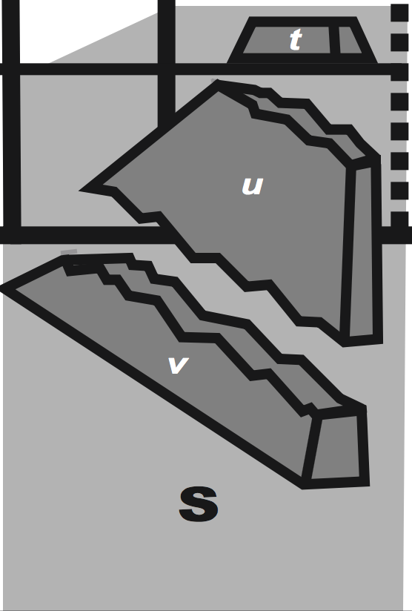
(Time of trouble, Fire on Christendom)
Dan 12:1 …and there shall be a time of trouble, such as never was since there was a nation even to that same time: and at that time thy people shall be delivered…
t
PLANE “M”
u
PLANE “N”
v
S

Slide 19
The transfer from the dominion of evil under Satan to that of righteousness under Christ will be accomplished by a general time of trouble.
(Gain through Pain)

Slide 20
20

Slide 22
Notes:
One of the first things we can do when trying to decipher the meaning of any scripture, is to look up the definitions of the Greek words from which the English words were translated. So let us look at the Greek definitions of four words contained within this passage and see what we come up with. (click)
Work Out
Salvation
Fear
Trembling

Slide 23
A.D. 29
1st Advent
A.D. 1874
Jesus 2nd Advent
A.D. 33 1/2
Jesus Raised
A.D. 1878
Saints Raised

Slide 24
7 years
A.D. 36
Call to Gentiles
A.D. 1881
End of General Call
Dashed Line
Dashed Line

Slide 25
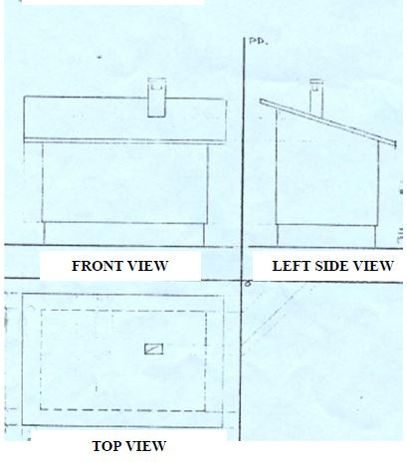

Slide 26
Each of these dispensations has its distinct seasons for the beginning and development of its work, and each ends with a harvest manifesting its fruits. The harvest at the close of the Jewish age was a period of forty years, lasting from the beginning of Jesus' ministry, when he was anointed of God by the Spirit (Acts 10:37,38), A.D. 29, until the destruction of Jerusalem, A.D. 70. In this harvest the Jewish age ended and the Gospel age began. (A 223)

Slide 27
Now notice on the chart the harvest or end of the Gospel age; notice the two parts into which it is divided--seven years and thirty-three years, the exact parallel of the harvest of the Jewish age. (A 238)

Slide 28
1916 the Pastor clearly stated that the parallels apply to the nominal systems, and not the true church.
It is my interpretation that the pastor uncoupled and separated the term harvest from the parallels in R5950 and the forwards.
“The parallels affected merely the nominal Jewish House there and the nominal Christian House here…”
“No parallels as between the Pentecostal Church and the true Church now are to be looked for...”

Slide 30
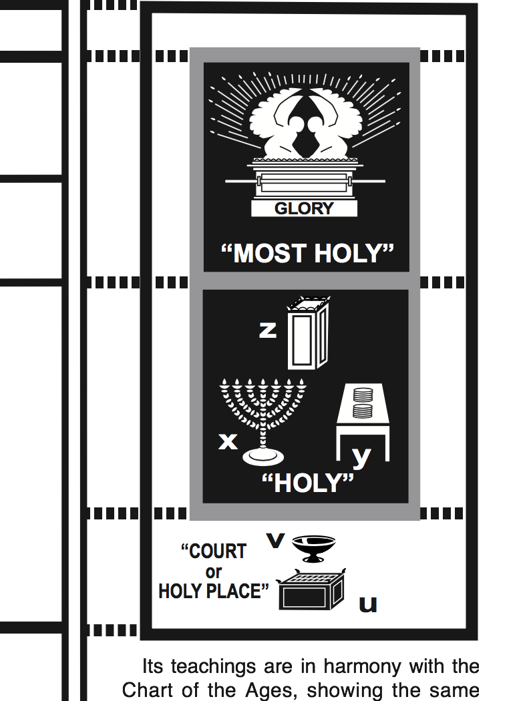
1 John 3:2 …but we know that, when he shall appear, we shall be like him: for we shall see him as he is.
Our Daily Sacrifices to God
John 8:32:
And ye shall know the truth, and the truth shall make you free.
GOLDEN LAMPSTAND
Be ye clean, that bear the vessels of the LORD
1 Tim 2:6 A ransom for all

Slide 31
Plane “L” Spirit Birth
Plane “M” Vital Justification
Plane “N” Tentative Justification

Slide 33
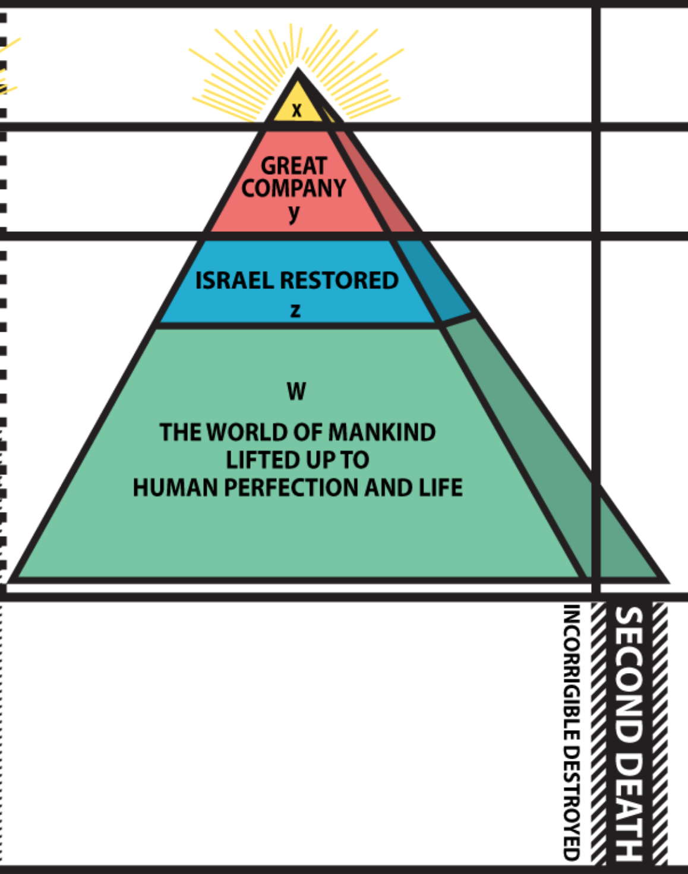
PLANE “K”
“x” The Christ will be the head of all things.
“y” The great company (spirit beings but not Divine beings)
“z” Israel restored – the head of earthly nations.
PLANE “L”
“W” The world restored to perfection – like the head of the human race, Adam before he sinned.
PLANE “N”
Isa. 65:20 – Those who refuse to progress in 100 years.
Rev. 20:9 Those in final trial at end of millennium.
At the end of the millennial age the great pyramid of the chart will be complete. During that 1000 years reign of Christ, the results of Adamic death will be gradually swallowed up or destroyed.

Slide 34
While the mass of mankind, groping in the darkness of ignorance, must await the actual developments of God’s plan, before they can realize the glorious character of the Divine Architect, it is the privilege of the child of God to see by faith and the light of his lamp the foretold glories of the future, and thereby to appreciate the otherwise mysterious dealings of the past and the present.
(A - Page 66)

Slide 35
Glory to God in the highest: on earth,
peace, good will toward men!

